Slide 1
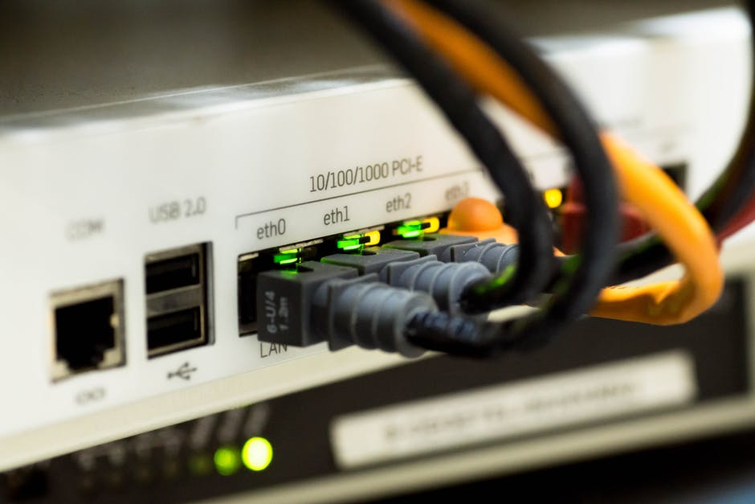

Introduction to data communications Lecturer: Itamar Cohen Lecture 1: Introduction
Vs.
Teasing question: ADSL is ? time faster than a carrier pigeon.
Answer
Notes:
Lecture 2, part 1: pkt / circuit switching
packet Vs. circuit switching
היום
היכרות ומנהלה
מבוא ומושגי יסוד
מה עשית השבוע וגו’

Slide 2
Logistics
ofanan@gmail.com, www.ofanan.com
Grading
Have a look at the syllabus
Appeals for any issue
By mail only
HWs submission instructions
Always improving…
please print only when necessary
… and use 2-sided printings

Slide 3
Course objectives
Learn basics of data communication and computer networks
Current & future trends
Understand HW constraints
Jobs
Network / Data systems engineers
Information Technology
Cyber security
Application developers
Self study

Slide 4
Learn how to learn
Repeat the material after every lesson
Don’t leave HWs to the last minute!
Self study
The course’s textbook
Google & Wiki
Reception hours
After the lecture
Coordinate by mail (Mon-Wed).

Slide 5
My teaching methodology
Use paper & pencil
For packets, timing diagrams etc
Simulate
Small, understandable design
Sanity checks
Units
Negative values
Notes:
* Emulate?

Slide 6
Personal word
My motivation
Your feedback & interest
I don’t know everything…
My aim is to help you to
succeed in job interviews
become good engineers
Breaks times

Slide 7

"כל האומר דבר בשם אומרו" וגו' – A note on the use of these ppt slide
We’re making these slides freely available to all (faculty, students, readers). They’re in PowerPoint form so you see the animations; and can add, modify, and delete slides (including this one) and slide content to suit your needs. They obviously represent a lot of work on our part. In return for use, we only ask the following:
If you use these slides (e.g., in a class) that you mention their source (after all, we’d like people to use our book!)
If you post any slides on a www site, that you note that they are adapted from (or perhaps identical to) our slides, and note our copyright of this material.
Thanks and enjoy! JFK/KWR.
All material copyright 1996-2012
J.F Kurose and K.W. Ross, All Rights Reserved
See additional references in the end of each ppt

Slide 8
Agenda
Acquaintance & administration
What’s the Internet
Network edge
Network core
Optimization criteria
Protocol layers

Slide 9




















The Internet: “nuts and bolts” view
Billions of connected computing devices:
hosts = end systems
Communication links
fiber, copper, radio, satellite
Packet switches: forward packets
routers and switches
PC
mobile network
server
wireless
laptop
global ISP
Smartphone
Things
home
network
regional ISP
wireless
links
wired
links
router
institutional
network
Notes:
9
ברגים ואומים
* שרת, Server יכול להיות גם מחובר לא ישירות לאינטרנט.
* גם המחשב שלכם יכול להיות שרת
* לא כל רשת חייבת להיות מחוברת לאינטרנט

Slide 10
What’s the Internet (Cont’)
Internet “network of networks”
Interconnected ISPs
Internet Service Providers
protocols control sending, receiving of msgs
e.g., TCP, IP, HTTP, Skype, 802.11
Standards
IETF: Internet Engineering Task Force
Publishes RFC: Request for comments

Slide 11
Internet structure: step by step
Question: how to connect millions of local networks?
…
…
access
net
access
net
access
net
access
net
access
net
access
net
access
net
…
…
access
net
access
net
access
net
access
net
access
net
access
net
…
access
net
access
net
…
access
net
Notes:
“Welcome 2 the machine”: compare to the development of autonomous cars

Slide 12
Internet structure: step 1
Full mesh
…
…
access
net
access
net
access
net
access
net
access
net
…
…
Full Mesh
(Clique):
O(N²)
links
access
net
access
net
…
…
…
access
net
access
net
…
access
net
access
net
access
net
…
access
net
…
access
net
access
net
…
access
net

Slide 13
Internet structure: step 2
Global ISP
…
…
access
net
access
net
access
net
access
net
access
net
access
net
access
net
…
…
global ISP
access
net
access
net
access
net
access
net
access
net
access
net
…
access
net
access
net
…
access
net

Slide 14
Internet structure: step 3
Global ISPs (aka tier 1)
AT&T, Sprint, Level3, …
…
…
access
net
access
net
access
net
access
net
access
net
ISP 1
access
net
access
net
…
ISP 2
…
ISP 3
access
net
access
net
access
net
access
net
access
net
access
net
…
access
net
access
net
…
access
net
Notes:
Step 3: The TIER1 ISPs connect each other, so as to allow global coverage
Step 4: Regional ISPs
Step 5: Finding of lions: Customer, which try to save money, PEER each other
via IXPs (Internet Exchange Points)
* Finally: Content Provider (e.g., Google, Microsoft, Akamai) appear
And have their own “nostro” networks

Slide 15
Internet structure: step by step
Tier 1 ISP
Tier 1 ISP
Google
IXP
IXP
IXP
Regional ISP
Regional ISP
access
ISP
access
ISP
access
ISP
access
ISP
access
ISP
access
ISP
access
ISP
access
ISP
Notes:
לספר להם את הסיפור עם youtube שאחת החברות רצתה לפתוח את החוזה העברת נתונים
at center: small # of well-connected large networks
“tier-1” commercial ISPs (e.g., Level 3, Sprint, AT&T, NTT), national & international coverage
content provider network (e.g, Google): private network that connects it data centers to Internet, often bypassing tier-1, regional ISPs

Slide 16
Real-world tier-1 ISP: Sprint
POP: point-of-presence
to/from backbone
peering
…
…
…
…
…
to/from customers
PoP means: “"קצה דרך באחזקת מעצ

Slide 17
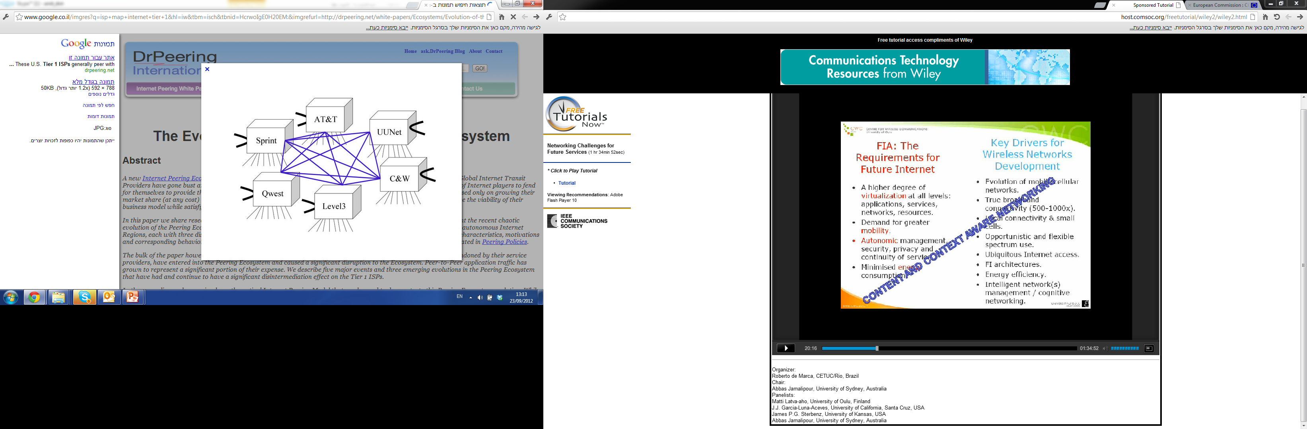
Other Real-world tier-1 ISPs
Notes:
לספר להם על הבעיה ש-youtube יצרה

Slide 18
Agenda
Acquaintance & administration
What’s the internet
The network edge
Access network
Physical media
The network core
Optimization criteria
Protocol layers

Slide 19
A closer look at network structure:
Network edge
hosts: clients and servers
servers often in data centers
Access networks, communication links
Network core
interconnected routers
network of networks
mobile network
global ISP
home
network
regional ISP
institutional
network

Slide 20

The network edge
end systems (hosts):
run application programs
e.g. Web, email
at “edge of network”
client/server model
client host requests, receives service from always-on server, eg
Web browser/server
email client/server
peer-peer model:
minimal (or no) use of dedicated servers
e.g. Skype, files sharing
peer-peer
client/server

Slide 21
Access networks and physical media
Q: How to connect end systems to edge router?
residential access nets
institutional access networks (school, company)
mobile access networks
Keep in mind:
bandwidth (bits per second) of access network?
shared or dedicated?

Slide 22





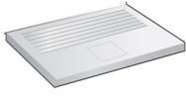
Access net: home network
wireless
devices
to/from headend or central office
often combined
in single box
cable or DSL modem
wireless access
point
router, firewall, NAT
Notes:
UFI

Slide 23
Agenda
Acquaintance & administration
What’s the internet
The network edge
Access network
Physical media
The network core
Optimization criteria
Protocol layers

Slide 24
Access net: Digital Subscriber Line (“Phone netw”)
Central Office
telephone
network
DSL
modem
splitter
DSLAM
voice, data transmitted over dedicated link at different freq.
ISP
DSL Access
Multiplexer
Asymmetric [down / up] stream rates
Very-high-bitrate DSL (VDSL)
Which is, in fact, also asymmetric.
The de-facto speed is affected by
Distance to the CO
Gauge of the cable
Electro-Magnetic Interference
How much the costumer paid
Notes:
Modem – converts D (from the PC) to Analog. The DSLAM converts it back to digital, multiplexing multiple users.

Slide 25
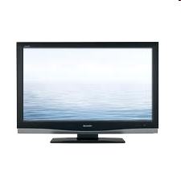


Access net: cable network (Hot)
cable headend
…
cable
modem
splitter
data, TV transmitted at different
frequencies over a shared cable

Slide 26
Access net: cable network (hot)
cable headend
…
cable
modem
splitter
C
O
N
T
R
O
L
V
I
D
E
O
V
I
D
E
O
V
I
D
E
O
V
I
D
E
O
V
I
D
E
O
V
I
D
E
O
D
A
T
A
D
A
T
A
1
2
3
4
5
6
7
8
9
Channels
Notes:
frequency division multiplexing: different channels transmitted
in different frequency bands

Slide 27
Access net: cable network (hot)
cable headend
…
cable
modem
splitter
Cable Modem
Termination System
data, TV transmitted at different
frequencies over shared cable
ISP
Data Over Cable Service Interface Specification
High BW (DOCSIS 3.1: 1/10Gbps up/downstream), but
BW may be divided to multiple heavy users
BW is subject to physical / financial constraints , similar to DSL

Slide 28
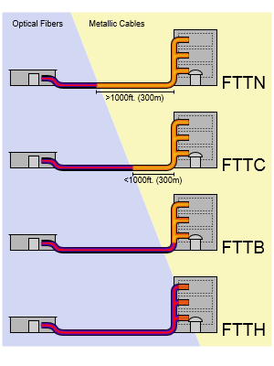
Fiber To The X
Q: how close to the desktop can the fiber get?
A: either to the
Node / Neighborhood
Hybrid Fiber Cable
Cabinet
Building
Home
Desktop

Slide 29






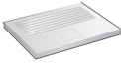


Enterprise access networks (Ethernet)
institutional link to
ISP (Internet)
institutional router
Ethernet
switch
institutional mail,
web servers
Typically used in companies, universities, etc
Rates: 10M / 100M / 1G / 10Gbps …

Slide 30


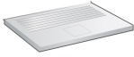





Wireless access networks
shared wireless access network connects end system to router
Via Base Station (aka Access Point)
wide-area wireless access
provided by telco (cellular) operator, 10’s km
3G, 4G, 5G
Wireless LANs:
within building (100 ft)
802.11b/g (WiFi)
to Internet
to Internet

Slide 31
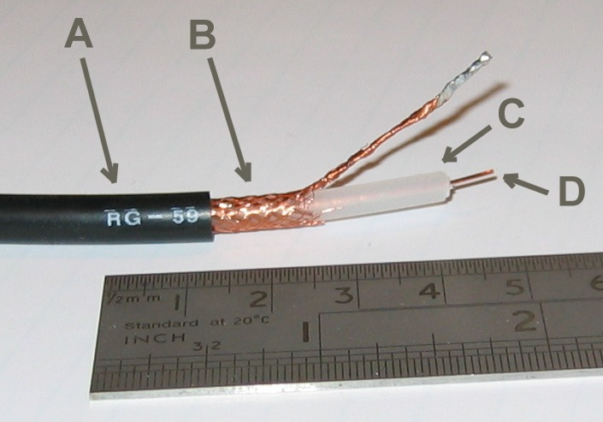
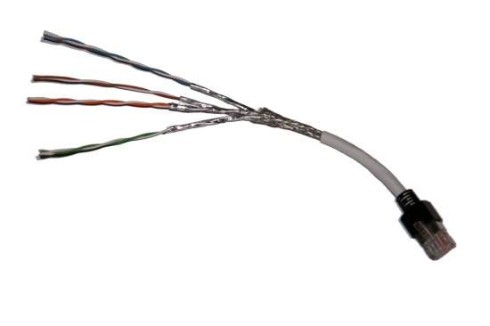
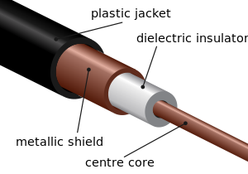
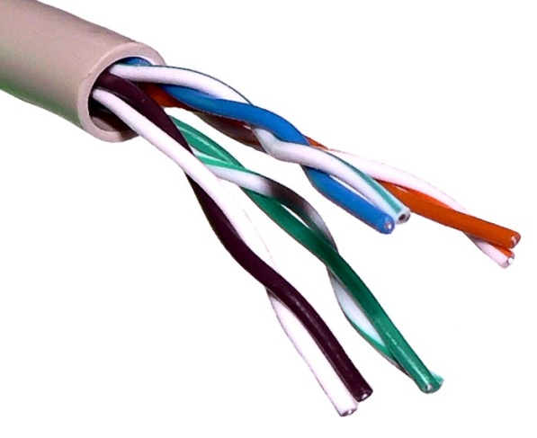
Physical Media: guided media
Twisted pair
aka ביסלי גריל
Why twist?
Made of copper
Either shielded
…or Unshielded
Coaxial cable
Coaxial means: בעל ציר משותף
In aim to decrease outer EMI
Common in cable TV

Slide 32
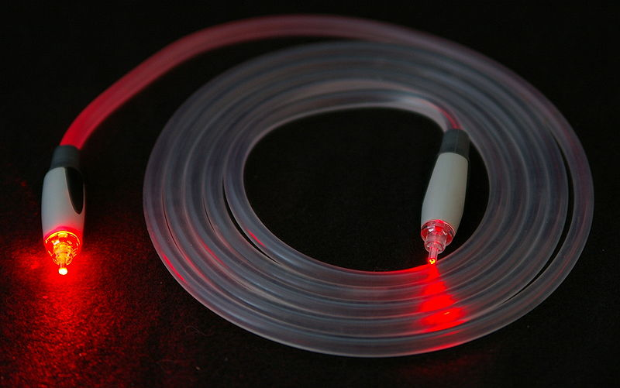

Physical guided media: Fiber optic cable
☺ Very fast: ~100 Gbps
Standards are named OC-n (Optical Carrier), where OC-1 carries 51.8 Mbps
So the BW of OC-768 is ~40Gbps
☺ Very low signal attenuation, even for ~100km
☹ Very expensive
Not necessarily the cables themselves, but – the xmt/rcvrs and switches

Slide 33
Physical unguided media: radio
Signal carried in electromagnetic spectrum
propagation environment effects:
Reflection
Obstacles
Interference
Can be classified by the distances
Very short distances (keyboard, mouse, earphones)
Medium distances: Wireless Local Area Network
WiFi
Wide are networks
4G, 5G cellular
Satellite
Geostationary: 36K kms above earth
Low-Earth Orbiting
Significant propagation delay

Slide 34
Agenda
Acquaintance & administration
What’s the internet
Network edge
Network core
Packet switching
Circuit switching
Optimization criteria
Protocol layers

Slide 35







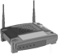

Packet switching
Hosts break application-layer messages into packets
Forward packets from one router to the next across links on path from source to destination
Each packet transmitted at full link capacity
Either source routing, or fixing only the next-hop

Slide 36
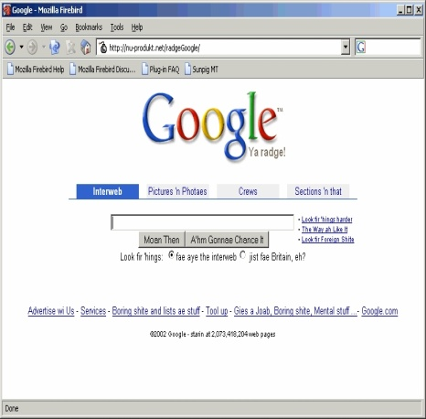

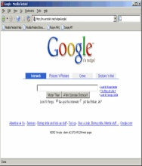
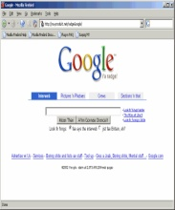
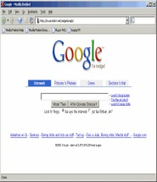
001100
011001
011001
11011
110101
http://www.adalovelace.com
http://www.adalovelace.com
Animation by: Nick McKeown &
Balaji Prabhakar
Ada Lovelace
Pros. & Cons.?

Slide 37
Packet switching: transmission rate
Denote:
packet length L
transmission rate R
Aka link capacity, link bandwidth
Fixed by the (bottleneck) link
packet
transmission
delay
time needed to
transmit L-bit
packet into link
L (bits)
R (bits/sec)
=
=

Slide 38



Packet-switching: store-and-forward
L bits
per packet
source
3
2
1
R bps
R bps
destination
Entire packet must arrive at router before it can be transmitted on next link

Slide 39
Packet-switching: queuing delay & loss
R = 100 Mb/s
C
A
D
R = 30 Mb/s
B
E
queue of packets
waiting for output link
If arrival rate > xmt rate, packets will queue
Packets may be dropped (lost) if buffer is full

Slide 40
Forwarding & Routing
Routing: determines source-destination route taken by packets
routing algorithms
Forwarding: move packets from router’s input to appropriate router output
Forwarding table
routing algorithm
local forwarding table
header value
output link
0100
0101
0111
1001
3
2
2
1
1
3
2
0111
dest address in arriving
packet’s header

Slide 41
Agenda
Acquaintance & administration
What’s the internet
Network edge
Network core
Packet switching
Circuit switching
Optimization criteria
Protocol layers

Slide 42
Transportation analogy
Routing alg: WAZE
Fwd. table: what to do in the next interchange
Circuit switching: rails

Slide 43
Circuit switching
End-end resources allocated & reserved for “call” between source & dest:
Guaranteed performance
circuit segment idle (and wasted) if not used by call
no sharing
Used in traditional telephone networks
Notes:
מירי רגב מדברת בטל' עם מתי כספי

Slide 44
Circuit switching: FDM & TDM
Freq
Division
Multiplexing
Example:
4 users
frequency
Time
Division
Multiplexing
time
frequency
time
Notes:
Two simple multiple access control techniques.
Each mobile’s share of the bandwidth is divided into portions for the uplink and the downlink. Also, possibly, out of band signaling.

Slide 45
Packet Vs. circuit switching
Packet switching
☺ Great for bursty data
☺ Resource sharing
☺ No call setup
☹ No BW guarantees - excessive congestion possible
☹ Packet delay and loss
☹ Protocols needed for reliable data transfer, congestion control

Slide 46
Agenda
Acquaintance & administration
What’s the internet
Network edge
Network core
Optimization criteria
Power
Delay
Throughput
Packet loss
Protocol layers

Slide 47


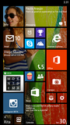
Power saving: motivation
Save power → Less diseases and death from polluting power plants
Save money
Electrical bills
Cooling costs
Battery life
Heat of devices
Inconvenient to the human user
Causes electrical problems

Slide 48
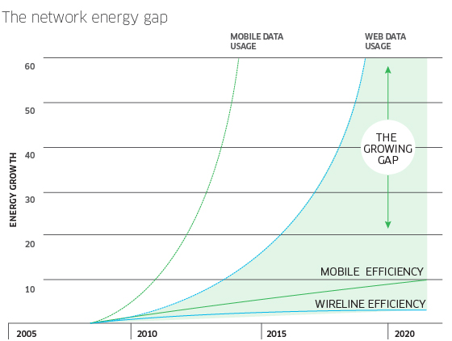
Green networking: industrial projects
Source: Alcatel-Lucent Eco-Sustainable Networks

Slide 49
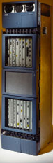
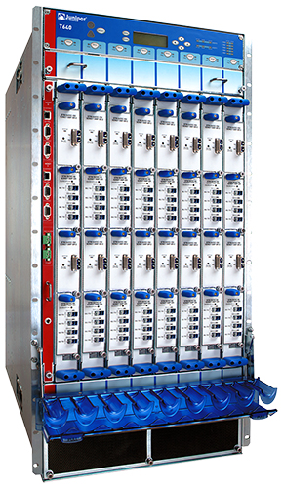
Big router is not a matchbox
Cisco GSR 12816
Juniper T640
Capacity: 640Gb/s Power: 5kW
Capacity: 320Gb/s Power: 3kW
50 cm
50 cm
2m
1m
60cm
75 cm

Slide 50
Agenda
Acquaintance & administration
What’s the internet
Network edge
Network core
Optimization criteria
Power
Delay
Throughput
Packet loss
Protocol layers
Notes:
למי כאן יש רשיון לאופנוע?

Slide 51
Four sources of packet delay
transmission
A
propagation
B
node
processing
queueing
d_{nodal} = d_{proc} + d_{queue} + d_{trans} + d_{prop}
dproc – depended upon the network equipment and the concrete packet’s characteristics
dqueue – depended upon link congestion
dtrans – depended upon pkt size & link rate
dprop – depended upon distance & (hopefully) speed of light

Slide 52
Delay: notations
Dproc + dqueue – aka Tproc, TD
dtra – aka Ttrans, Txmt, or Tx
dprop – aka Tpd
Notes:
Mb → this is contrast to Mebibit=2^20 bits

Slide 53
Packet delay: Kahoot.it
מעבירים חבילת מידע יחידה מארה"ב לאב"ג, דרך נתב יחיד. נתונים:
Pkt size: 12.5kBytes
Link rates: 100 Mbps
Distance: 20,000 kms
Propagation speed: 2*10^8 mps
Tproc = 1 ms
Tq = 0
כמה זמן עובר מרגע שמתחילים לשדר את החבילה בארה"ב, ועד שהיא מגיעה במלואה ליעד באב"ג?

Slide 54
Packet delay: numerical example
transmission
A
propagation
B
node
processing
queueing
d_{nodal} = d_{proc} + d_{queue} + d_{trans} + d_{prop}
dproc + dqueue → 100 nsec
dxmt – 12.5kB packet @ 100 Mbps →
dprop – 20k km @ 2*10^8 m/sec →
Notes:
Dxmt: 12.5kB / 100 Mbps = 100 kb / 100 Mbps = 1 ms
Dprop: 20k kms = 20*10^6 m = 2*10^7 m → Dprop = 0.1 sec
2*Txmt + Tprop + Tproc + Tq = 2*100kb / 100 Mbps + 20 Mm / 2*10^8 mps + 1 ms =
= 2 ms + (20 / 200) s + 1 ms = 103 ms.

Slide 55
Agenda
Acquaintance & administration
What’s the internet
Network edge
Network core
Optimization criteria
Power
Delay
Throughput
Packet loss
Protocol layers

Slide 56
Throughput
Throughput: rate (bits/sec) at which bits transferred between sender/receiver
Goodput: rate of the useful data
Eg, the file sent – excluding headers & trailers
pipe that can carry
fluid at rate
R_{s} bits/sec
pipe that can carry
fluid at rate
R_{c} bits/sec
server, with
file of F bits
to send to client
link capacity
R_{s} bits/sec
server sends bits
(fluid) into pipe
link capacity
R_{c} bits/sec

Slide 57
Agenda
Acquaintance & administration
What’s the internet
Network edge
Network core
Optimization criteria
Power
Delay
Throughput
Packet loss
Protocol layers

Slide 58
Packet loss
Queue (aka buffer) preceding link has finite capacity
Packet arriving to (almost) full queue may be dropped (aka lost, rejected, discarded)
Upon realizing that a packet was lost, the source node / previous node may retransmit it
buffer
(waiting area)
A
packet being transmitted
B
packet arriving to
a full buffer is lost

Slide 59
Agenda
Acquaintance & administration
What’s the internet
Network edge
Network core
Optimization criteria
Power
Delay
Throughput
Packet loss
Protocol layers

Slide 60
Protocol “Layers”
Networks are complex!
many “pieces”:
hosts
routers
links of various media
applications
protocols
hardware, software
Question:
Is there any hope of organizing structure of network?

Slide 61
Internet Layers: a postal service analogy
Application: online purchase
Transport: express / registered / regular
Network: Use WAZE to find best route
link: Terminal’s gate, interchange exit
physical: Conveyor belt / crane / porters
application
transport
network
link
physical

Slide 62
Why layering?
Hierarchical, top-down planning
Divide a complex task to smaller, easier tasks.
Easier maintenance
A change of implementation of layer’s service is transparent to rest of system

Slide 63
Breaking data in segments
Data

Slide 64
The complete packet
Application Header
Presentation Header
Session Header
Transport Header
Network Header
Link Header
Frame Preamble
Data
Data Link Trailer(CRC)
Packet

Slide 65
Packet creation process
Data
Data
65
Introduction 1-65

Slide 66
Internet protocol stack
Why “Stack”?
Application: e.g. e-mail, web, file sharing
Transport: (un)reliable proc.-to-proc. data transfer
Network: end-to-end routing
Link: transfer between neighboring nodes
Physical: bits “on the wire”
application
transport
network
link
physical
Notes:
Physical: See
https://en.wikipedia.org/wiki/Line_code

Slide 67
OSI reference model (by ISO)
OSI: Open Source Interconnection
ISO: International Organization for Standardization
presentation: allow applications to interpret meaning of data, e.g., encryption, compression
session: synchronization.
Eg: migration
Internet stack “missing” these layers!
these services, if needed, must be implemented in application
application
presentation
session
transport
network
link
physical

Slide 68
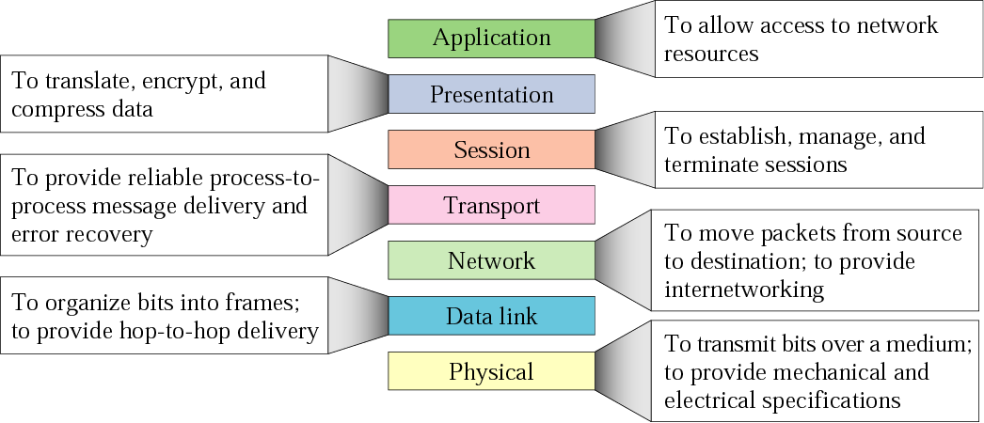
OSI model

Slide 69
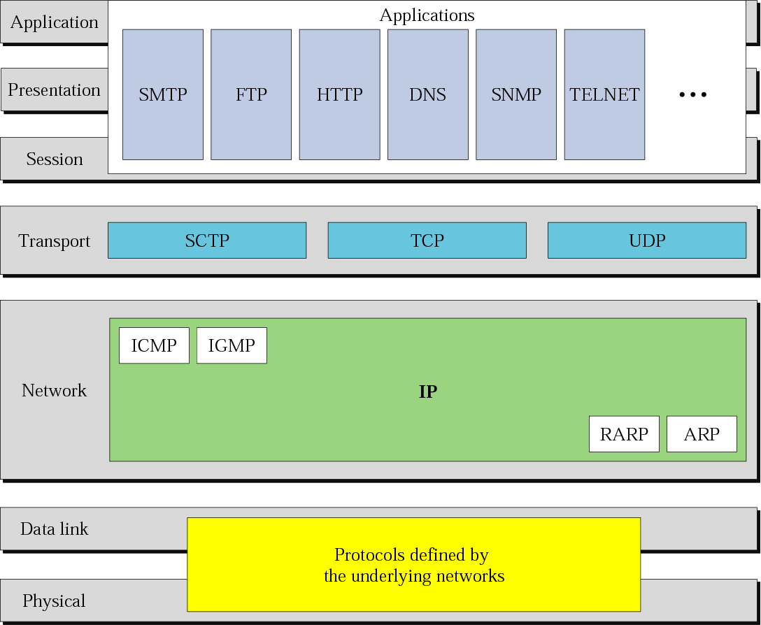
The 5 / 7 layers
Notes:
L5
Simple Mail Trans’ Prot’.
Domain Name System.
HyperText Transfer Prot’.
Simple Netw. Mgmt. Prot’.
L4
UDP (User Datagram Prot’) assumes that error checking and correction is either not necessary or performed in the application, avoiding the overhead of such processing at the network interface level. Time-sensitive applications often use UDP because dropping packets is preferable to waiting for delayed packets, which may not be an option in a real-time system.
UDP's stateless nature is also useful for servers answering small queries from huge numbers of clients. Unlike TCP, UDP supports packet broadcast (sending to all on local network) and multicasting (send to all subscribers).
UDP is used for DNS, streaming media (IPTV, VoIP) and online games.
TCP (Transmission Ctrl Prot’).
SCTP (Stream Ctrl Transmission Prot’) – provides reliability, sequencing and cong. ctrl. as in TCP; SCTP is msg-oriented, as is UDP.
L3
I Group Management Prot.
Other Network Layer Protocols:
IPSec (Secure).
Routing protocols (BGP, RIP, OSPF).

Slide 70
Why NOT layering?
In practice, the borders between the layers are not definite
The “link layer” of delivery (flight / boat / car) impacts the higher layers
Layering considered harmful
Duplicate functions (eg ECC / Checksum)
Parallel to multiple identical security checks at an airport
Knowledge about other layers may enable optimizations
Eg – is there another branch of the destination company in case of a traffic jam?

Slide 71

Conclusion
Communication networks are imperfect
Many problems stem from “historical reasons”

Slide 72
References
EE384x, Packet Switch Architectures – lectures slides by Nick McKeown & Balaji Prabakhar, spring 2012, Stanford University

